Slide 1
ADS ML – Week 6 Naive Bayes

Slide 2
Goals: At the end of this lesson …
You know what Naive Bayes means.
You are able to apply this concept to a small dataset.

Slide 3
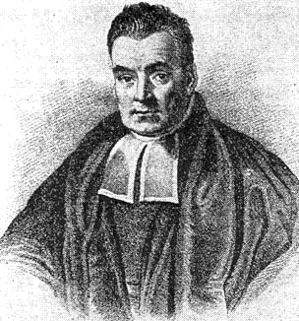
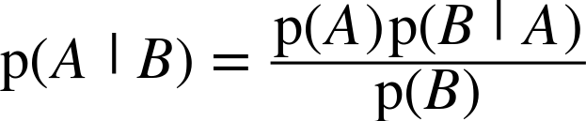
Naive Bayes
Thomas Bayes (1702 – 1761).
Statistician, philosopher and Presbyterian minister.
His famous algorithm is known as naïve Bayes or Bayes’s theorem (he was not naïve ☺).

Slide 4
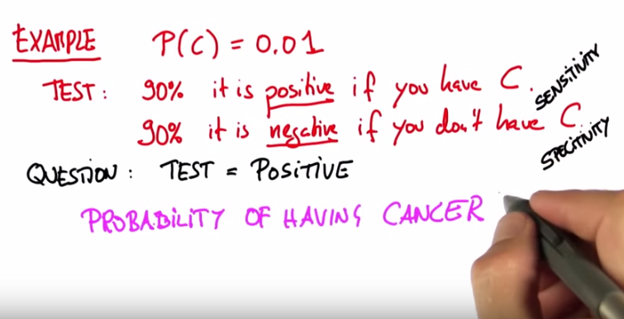
Seriously ill? Or just a false positive test

Slide 5
Conditional Probability
… [explain]

Slide 6


The Cookie Problem
Bowl 1:
15 vanilla cookies
5 chocolade cookies
Bowl 2:
10 vanilla cookies
10 chocolate cookies
Choose one of the bowls (at random) and pick a cookie.
Cookie is vanilla. What is probability it came from bowl 1?

Slide 7
The Cookie Solution
P(Bowl 1 | vanilla) is not easy !
But P(vanilla | Bowl 1) is !
By using Bayes theorem: P(B₁ | v) = P(B₁) P(v | B₁) / P(v)
P(B₁) = 1/2, the prior
P(v | B₁) = 3/4, the likelihood
P(v) = 5/8, probability of drawing a vanilla cookie from either bowl is 50 out of 80. This is called the normalizing constant.
P(B₁ | v), the posterior is now computable (= ?) !
Notes:
Answer: 3/5

Slide 8
Now with Data
What is the probability of a certain outcome or hypothesis H (spam) in light of some data D (word) ?
Diachronic interpretation !
The probability of the hypothesis changes as we see (new) data.
P(H | D) = P(H) P(D | H) / P(D)
Prior P(H), the probability of the hypothesis before we have seen the data.
Likelyhood P(D | H), you can usually find this by counting in your labelled dataset.
P(D) can also be found by plain counting.
Posterior P(H | D) can now be computed

Slide 9
Coding Naive Bayes
… [example code]

Slide 10
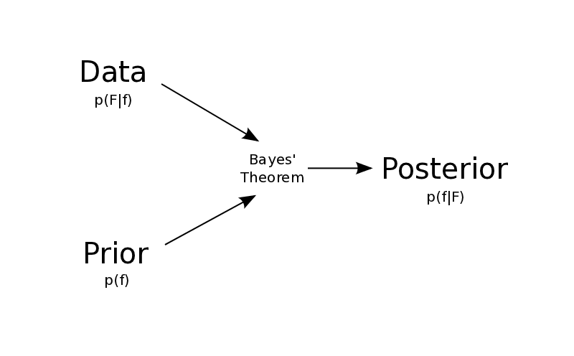
Naive Bayes Summary
Naive Bayes works very good for text classification problems.
Assumption is that all features are independent …that is why it’s called naive!
P(D|H)
P(H|D)
P(H)

Slide 11
Assignment: “Who Wrote this E-mail?”
Generate in Python a corpus (tekst) dataset. Let’s say:
50 typical sentences of Mary
50 typical sentences of John
Sentence is between 5 and 15 words.
Use as input word preferences (e.g. in percentages) of Mary and John.
Apply analysis as given in TinyLanguage notebook
Play with the parameters.
Tiny language input example:
 | John | Mary
soccer | 20% | 2%
sweet | 5% | 15%
car | 12% | 4%
difficult | 5% | 4%
kid | 12% | 23%
home | 7% | 14%
…

